Slide 1

Project 3 Subreddit Classification
r/datascience r/dataengineering

Slide 2
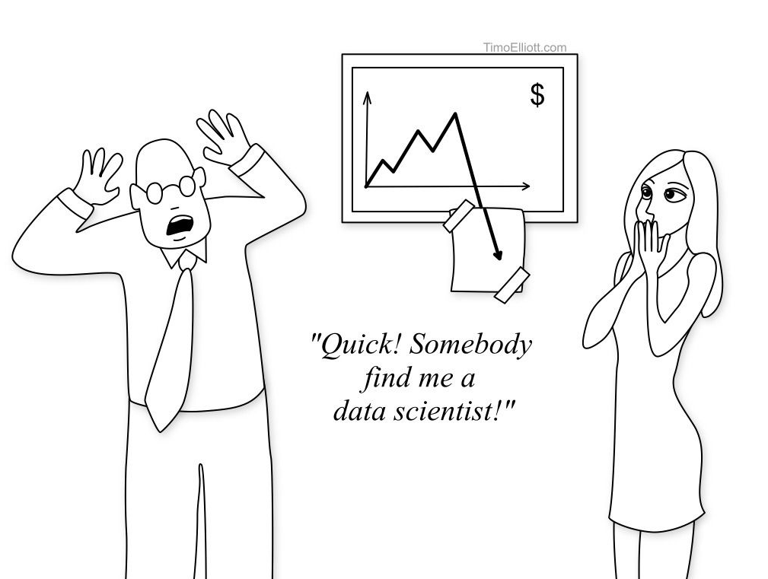
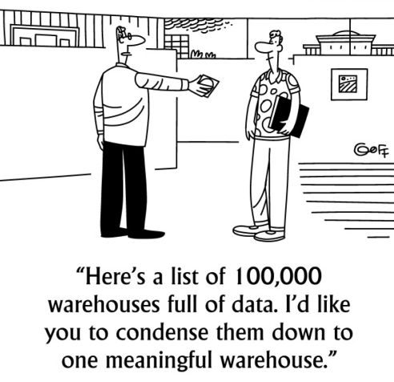
Problem Statement
For someone considering a career switch to the data industry,
Would one be able to decide which path to transit into?
What are the key differences between the two?

Slide 3
Workflow
Data Collection
Exploratory Data Analysis
Data Cleaning / Pre-processing
Model Testing / Evaluation
Conclusions and Recommendations

Slide 4
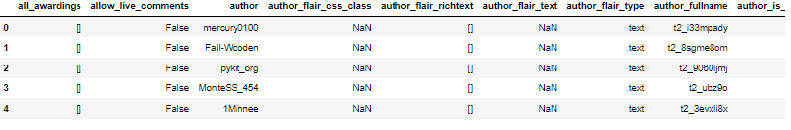
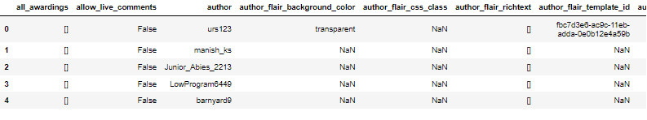
Data Collection
Data collected using Pushshift’s API from Reddit’s
r/datascience (1,000 posts)
r/dataengineering (1,000 posts)
Data collected from to 21st Dec 2021 to 13th Jan 2022

Slide 5
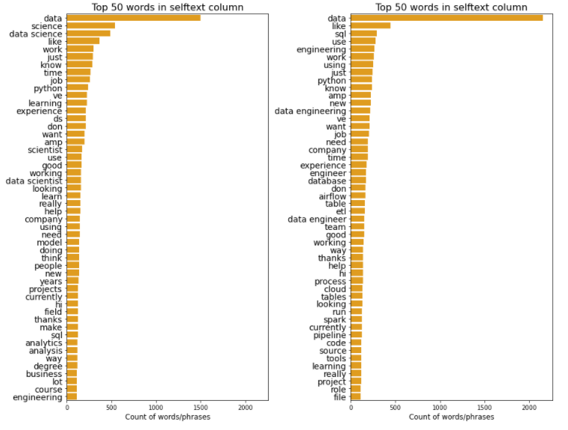
Exploratory Data Analysis
Data Science
Data Engineering
Top 50 words using unigrams and bigrams
Heavily skewed towards words existing in subreddit topics
Contains words from Reddit specific markdown formatting
Filler words (‘hi’, ‘like’, ‘want’)
Text Cleaning
Converted to lowercase
Removed HTML links, special characters, whitespaces, Reddit specific markdowns
Lemmatization

Slide 6
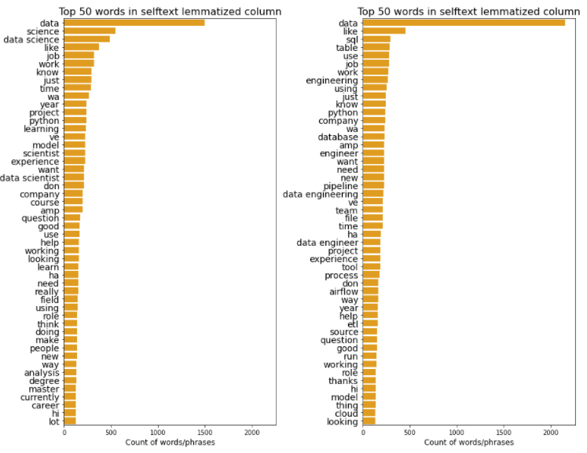
Text Cleaning

Slide 7
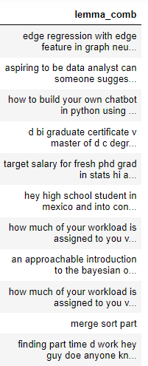
Pre-processing
Dropped removed and deleted posts
Text cleaning
Fill null values in selftext columns
Lemmatization
Merging title and selftext columns
Final number of rows = 1901 rows

Slide 8
Model Testing
Models tested
Multinomial Naïve Bayes (CountVectorizer)
Multinomial Naïve Bayes (TfidfVectorizer)
Logistic Regression (CountVectorizer)
Logistic Regression (TfidfVectorizer)
Random Forest (CountVectorizer)
Random Forest (TfidfVectorizer)

Slide 9
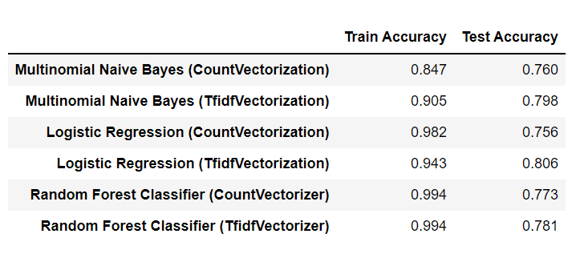
Model Performance

Slide 10
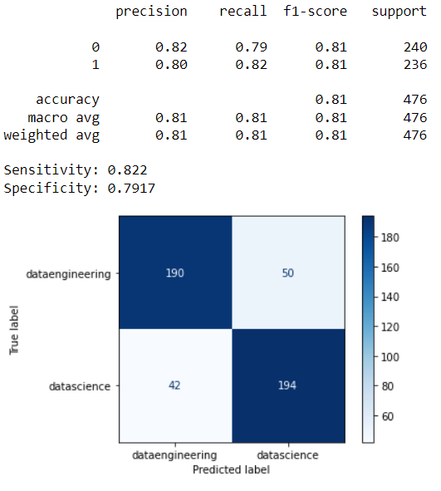
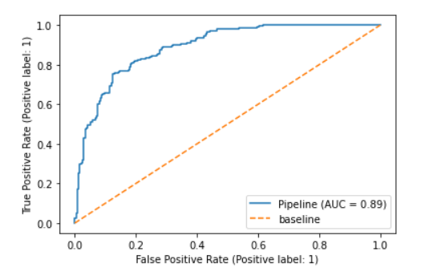
Model Performance

Slide 11
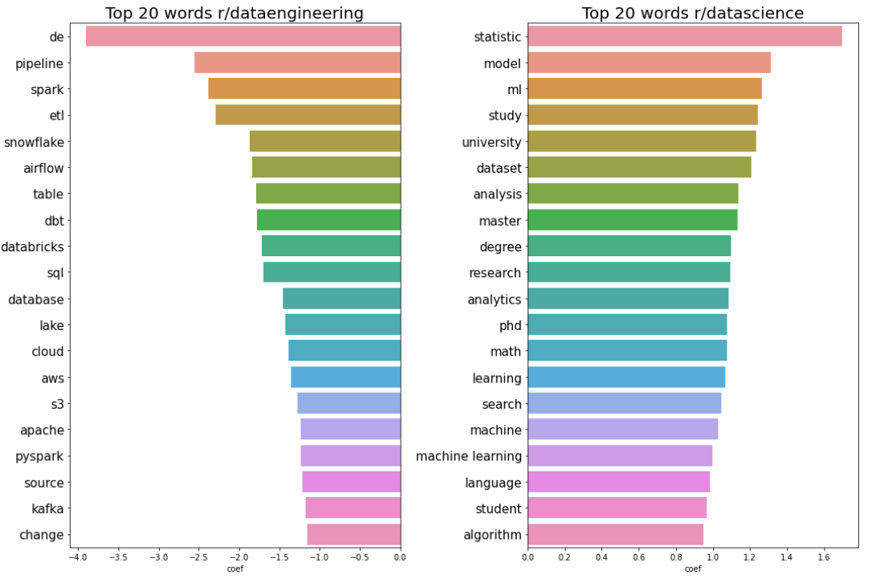
Top 20 words from each subreddit

Slide 12
Conclusions and Recommendations
Accuracy score of 80% is a reasonable score given the relative similarity between both subreddits.
Data Science
Topics tend to tap on one’s academic strength
High barrier of entry as suggested by the top 20 words
Suitable for people who likes working with datasets, machine learning models and have a good understanding of statistics
Data Engineering
Focuses on the tools necessary for data engineering
Familiarity with tools such as apache, spark, snowflake, airflow and ETL (extract, transform and load)
Lower barrier of entry compared to data scientists, values experience over education
Suitable for people who likes to develop systems for data collection and processing
Future steps
Collect more data / information
Increase range of models to test on, such as SVM, K Nearest Neighbour, Word2Vec and GloVE.

